Slide 1

PACE – Final Presentation
Presenter Name: Santosh Kumar

Slide 2

Overview
Purpose:
-Enhance professional skills in communication,
management, and client engagement.
Benefits:
-Boosts confidence
-Improves writing and problem-solving
-Strengthens project and client communication
Topics Covered:
1.Problem Solving
2. Building Confidence
3. Project Management
4.Client Call
5.Business Writing Skills
6.Presentation Skills

Slide 3
1. Problem Solving
Identify the problem
Generate the possible solution
Selecting best solution
Stage 1. Defining the Problem
A problem statement must contain
  What? What is happening?
  Where? Where is it happening?
  When? When did it start?
  How Much? To what extent it is impacting .How big is the impact?
  How do I know? How did you become aware of it?

Slide 4

Diagnosis
Diagnose the current state of your problem & identify the root causes and improvement levers
Use 5 whys technique to find the root cause
Apply pareto analysis to priorities the causes
Use Fish bone
Why is this happening?
Why is that happening?
How do you think that is the case?
How do you think that situation exist ?
Why do you feel so ?
Notes:
- Add more slides if required

Slide 5

Design
Generate all possible solutions
Brainstorm Possible solution without judgement
Encourage creativity and collaboration
Find out all possible solution to solve the problem
Notes:
- Add more slides if required

Slide 6

Delivery
Delivery: Chalk out an implementation plan and mention how effectiveness/impact will be measured
Choose the best approach and implement
Review and evaluate the solution .
Make some necessary adjustment to improve outcome.
Notes:
- Add more slides if required

Slide 7
Realtime example
Example : Problem solving with real time example
Background
An e-commerce company hosts its platform on a cloud infrastructure. During major sales events (like Diwali or Black Friday), the site experiences unexpected downtime, leading to revenue loss and customer dissatisfaction.
Problem
An e-commerce company hosts its platform on a cloud infrastructure. During major sales events (like Diwali or Black Friday), the site experiences unexpected downtime, leading to revenue loss and customer dissatisfaction.
Impact
15% drop in customer retention post event.
Estimated ₹10 lakh revenue loss per hour of downtime
Negative brand perception on social media
Notes:
- Add more slides if required

Slide 8
Realtime example
Example : Problem solving with real time example
Root Cause Analysis:
People: Lack of load testing expertise
Methods: No automated scaling policies
Machines: Single point of failure in database cluster
Materials: Poorly optimized product images increasing load
Measurements: Inadequate real-time monitoring
Environment: Unpredictable traffic surges
Solutions Generated:
Implement auto-scaling and load balancing
Optimize database queries and introduce caching
Conduct regular load testing before events
Use CDN for static content delivery
Improve monitoring with alert systems
Notes:
- Add more slides if required

Slide 9
Realtime example
Example : Problem solving with real time example
Selected Solution:
A combination of auto-scaling, database optimization, and CDN integration was chosen based on cost-benefit analysis and implementation feasibility.
VUCA Context:
Volatility: Traffic spikes during unpredictable times
Uncertainty: User behavior during events
Complexity: Multiple interdependent systems
Ambiguity: No clear failure pattern
Leadership in a VUCA World
Adaptive leadership and emotional intelligence
• Sensemaking and strategic foresight
• Building trust and transparency
• Encouraging innovation and continuous learning
Notes:
- Add more slides if required

Slide 10
2. Building Confidence
Purpose:
To empower individuals with strategies to build and sustain confidence in professional settings.
Benefits:
- Enhances communication and leadership presence
- Encourages proactive participation and decision-making
- Builds resilience and self-awareness
Topics Covered:
-Strategy : public speaking Practice
-Strategy : Goal setting
-Strategy : Seeking feedback
-Strategy : Tracking progress

Slide 11
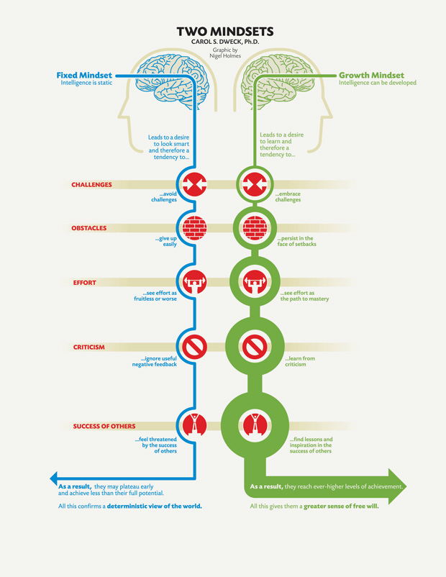
2. Building Confidence

Slide 12
Strategy : Public speaking practice
• Join public speaking groups like Toastmasters
• Volunteer for team presentations or meetings
• Practice storytelling and elevator pitches

Slide 13
Strategy : Goal Setting
• Set SMART goals (Specific, Measurable, Achievable, Relevant, Time-bound)
• Break large goals into smaller milestones
• Track progress and celebrate achievements

Slide 14
Strategy : Seeking Feedback
• Request feedback from peers and mentors
• Use feedback constructively to improve performance
• Create a feedback loop for continuous growth

Slide 15
Strategy : Tracking Progress
• Maintain a confidence journal to log achievements
• Reflect on challenges overcome and lessons learned
• Use progress reviews to boost morale and motivation

Slide 16
3. Project Management
Purpose:
To equip participants with essential project management skills.
Benefits:
Improved planning and execution.
Enhanced team collaboration.
Better risk mitigation and delivery outcomes.
Topics Covered:
Defining Scope and Objectives
Planning and Scheduling
Team Coordination
Risk Management
Post-Project Review

Slide 17
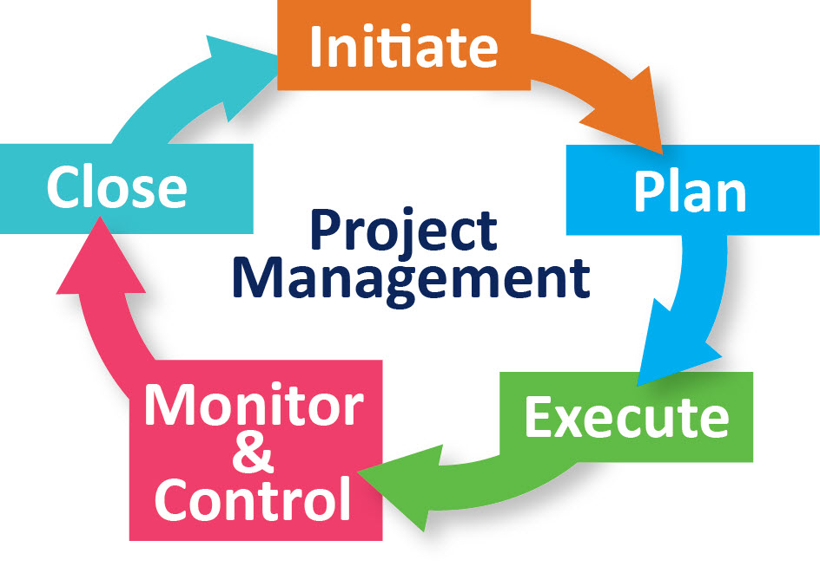
Strategy : Project Management

Slide 18
Defining Scopes and objectives
Clearly define project goals and deliverables.
Use SMART criteria for objectives.
Example: Launching a new website with defined features and timeline.

Slide 19
Planning and scheduling
Break down tasks using Work Breakdown Structure (WBS).
Use Gantt charts or Agile boards for scheduling.
Example: Software development team plans sprints using Jira.

Slide 20
Team coordination
Assign roles and responsibilities clearly.
Use collaboration tools like Slack or Microsoft Teams.
Example: Cross-functional team uses daily stand-ups to stay aligned.

Slide 21
Risk Management
Identify potential risks early.
Use risk matrix to assess impact and likelihood.
Example: Construction project mitigates weather delays with buffer time.

Slide 22
Post Project Review
Conduct lessons learned sessions.
Document successes and areas for improvement.
Example: Marketing team reviews campaign metrics to refine future strategies

Slide 23
4. Client Call
Purpose:
To develop effective client communication skills.
Benefits:
Builds trust and rapport with clients.
Enhances clarity and professionalism.
Improves project outcomes and client satisfaction.
Topics Covered:
Preparing for the Call
Active Listening
Managing Expectations
Follow-up Communication
Building Rapport

Slide 24
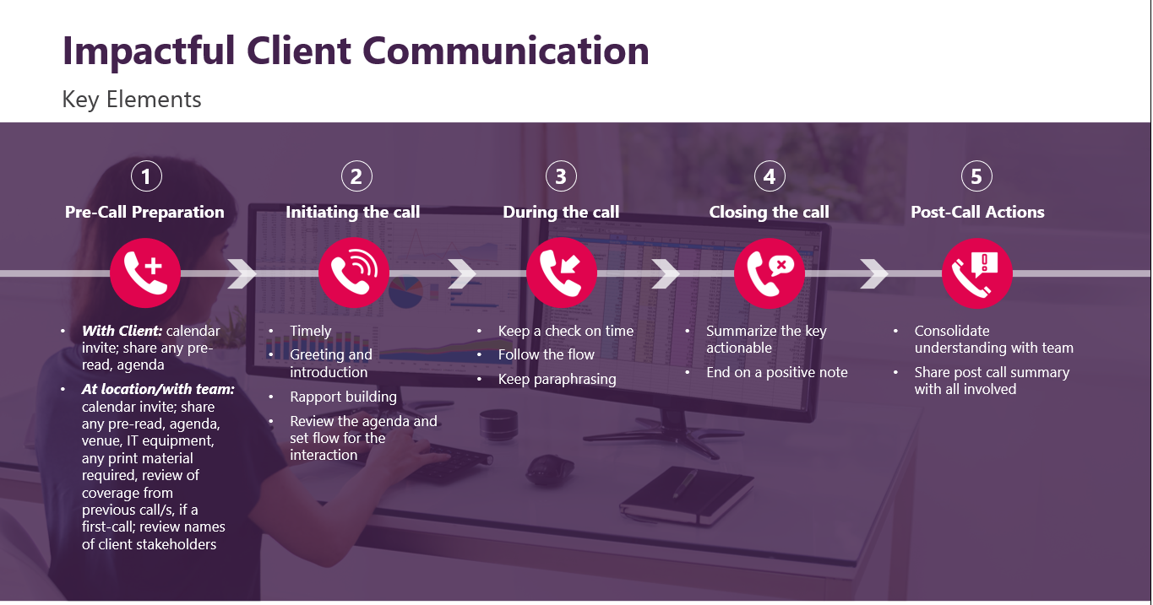
Client Call

Slide 25
Preparing for the call
Research the client's background and project context.
Set a clear agenda and share it in advance.
Choose a quiet, professional environment.
Example: A consultant reviews the client's website and recent reports before a kickoff call.

Slide 26
Active Listening
Focus on the speaker without interrupting.
Use verbal and non-verbal cues to show engagement.
Summarize and confirm understanding.
Example: A project manager paraphrases client concerns to ensure clarity.

Slide 27
Managing Expectation
Clearly define deliverables, timelines, and responsibilities.
Avoid overpromising; be transparent about limitations.
Document agreements and share follow-up notes.
Example: A team lead outlines scope boundaries during a client onboarding call.

Slide 28
Building Rapport
Show genuine interest in the client's goals.
Be respectful, empathetic, and responsive.
Maintain consistent and friendly communication.
Example: An account manager remembers client preferences and checks in regularly.

Slide 29
Managing Expectation
Clearly define deliverables, timelines, and responsibilities.
Avoid overpromising; be transparent about limitations.
Document agreements and share follow-up notes.
Example: A team lead outlines scope boundaries during a client onboarding call.

Slide 30
5. Business Writing
Purpose:
To enhance professional communication through effective business writing.
Benefits:
Improve clarity and impact of written communication
Boost professional image
Increase efficiency in workplace communication
Topics Covered:
Introduction to Business Writing
Importance of Business Writing
Key Principles
Common Types of Business Writing
Tips for Effective Writing
Examples and Practice
Summary and Q&A

Slide 31
Introduction to business writing
Business writing involves clear, concise, and purposeful communication used in professional settings. It includes emails, reports, proposals, and other documents.

Slide 32
Importance of business writing
Effective business writing enhances communication, improves professionalism, and helps achieve business goals. It ensures clarity and reduces misunderstandings.

Slide 33
Key Principle of business writing
Clarity: Use simple and direct language.
Conciseness: Avoid unnecessary words.
Tone: Maintain a professional and respectful tone.
Structure: Organize content logically.

Slide 34
Common type of business writing
Emails: Used for quick and direct communication.
Reports: Provide detailed analysis and findings.
Memos: Share internal information and updates.

Slide 35
Tips for Effective writing
Know your audience
• Use active voice
• Proofread your work
• Use bullet points for clarity
• Avoid jargon and complex language

Slide 36
Example and practice
Example Email:
Subject: Meeting Reminder
Dear Team,
This is a reminder for our meeting scheduled on Monday at 10 AM.
Best regards,
Santosh Kumar
Practice:
Write a memo announcing a new company policy.

Slide 37
Summary and Questions
Business writing is a vital skill for professional success. Focus on clarity, tone, and structure. Practice regularly to improve.
Questions?

Slide 38
6. Presentation Skills
Purpose:
To develop effective communication and delivery techniques for professional presentations.
Benefits:
Enhances clarity and confidence
Improves audience engagement
Strengthens message delivery
Topics Covered:
Preparing for the Call
Active Listening
Managing Expectations
Follow-up Communication
Building Rapport

Slide 39
The information contained in this report has been obtained from reliable sources. The output is in accordance with the information available on such sources and has been carried out to the best of our knowledge with utmost care and precision. While Evalueserve has no reason to believe that there is any inaccuracy or defect in such information, Evalueserve disclaims all warranties, expressed or implied, including warranties of accuracy, completeness, correctness, adequacy, merchantability and / or fitness of the information.

